Slide 1
Software Requirement Engineering Software Engineering Department Spring 2025
Muhammad Huzaifa Shah

Slide 2
Week Agenda
Introduction to Process Models
Traditional vs. Agile Requirements Engineering
Documenting Requirements
Quality Measurement in Requirements Engineering
Activity & Case Study

Slide 3
Week Agenda
Introduction to Process Models
Traditional vs. Agile Requirements Engineering
Documenting Requirements
Quality Measurement in Requirements Engineering
Activity & Case Study

Slide 4
Introduction to Process Models
Definition & Importance:
Process models define structured methodologies for software development.
They help in planning, executing, and managing software projects efficiently

Slide 5
Introduction to Process Models
Types of Process Models
Waterfall Model (Linear, Sequential Approach)
V-Model (Verification & Validation at Each Step)
Incremental Model (Development in Small Parts)
Spiral Model (Risk-Driven Approach)
Agile Model (Iterative, Collaborative Approach)

Slide 6
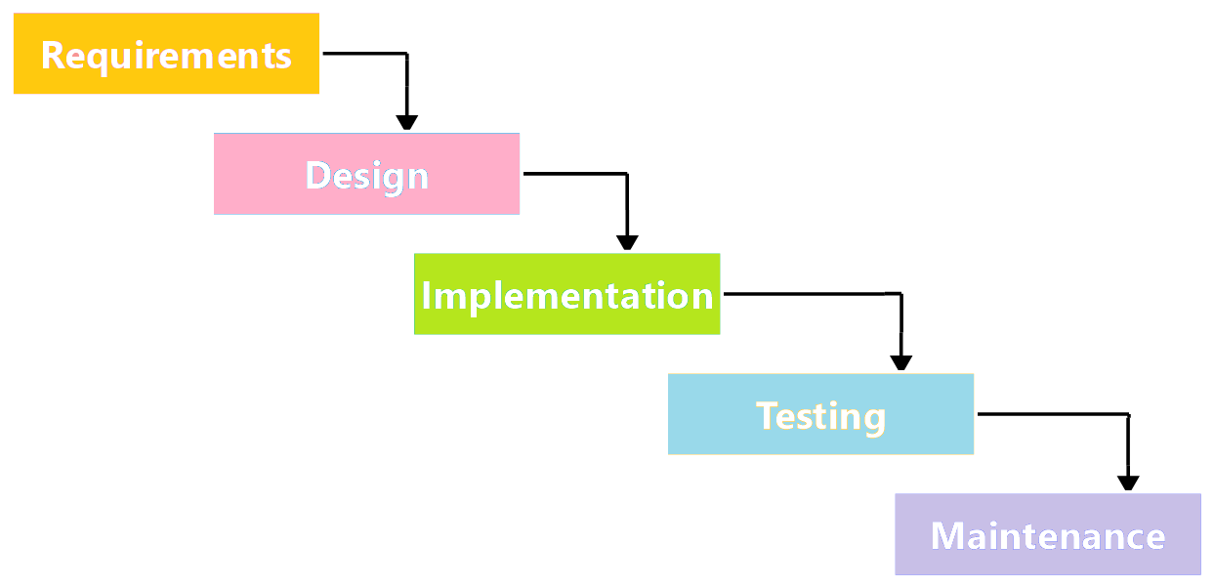
Introduction to Process Models
1. Waterfall Model (Linear, Sequential Approach)
Follows a strict sequence: Requirements → Design → Implementation → Testing → Deployment → Maintenance.
Used in projects with well-defined and fixed requirements.

Slide 7
Introduction to Process Models
1. Waterfall Model (Linear, Sequential Approach)
Strengths: Easy to manage, clear documentation.
Weaknesses: Inflexible, difficult to accommodate changes.
Example: Used in large-scale government or defense projects.

Slide 8
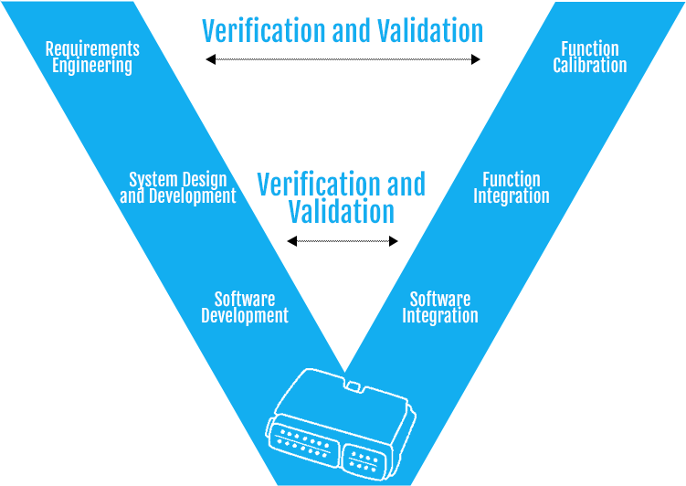
Introduction to Process Models
2. V-Model (Verification & Validation at Each Step)
Extension of the Waterfall model with a focus on testing at every stage.
Each phase has a corresponding validation/testing phase.

Slide 9
Introduction to Process Models
2. V-Model (Verification & Validation at Each Step)
Strengths: High reliability due to early defect detection.
Weaknesses: Expensive and time-consuming.
Example: Used in safety-critical systems like medical devices and avionics software.

Slide 10
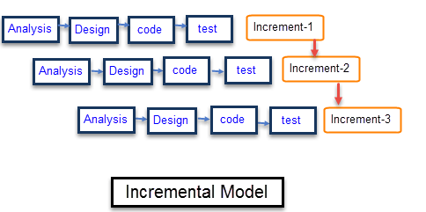
Introduction to Process Models
3. Incremental Model (Development in Small Parts)
Divides the project into smaller modules, each developed and tested incrementally.
Each increment delivers part of the functionality.

Slide 11
Introduction to Process Models
3. Incremental Model (Development in Small Parts)
Strengths: Allows early feedback, more flexible than Waterfall.
Weaknesses: Requires proper planning to integrate all increments.
Example: Used in developing web-based applications with evolving features.

Slide 12
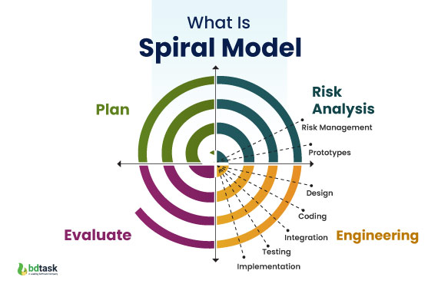
Introduction to Process Models
4. Spiral Model (Risk-Driven Approach)
Focuses on iterative risk assessment and mitigation.
Each cycle (spiral) includes Planning, Risk Analysis, Engineering, and Evaluation.

Slide 13
Introduction to Process Models
4. Spiral Model (Risk-Driven Approach)
Strengths: Handles risks proactively, suitable for large and complex projects.
Weaknesses: Expensive, requires expertise in risk management.
Example: Used in aerospace and banking systems where risk assessment is crucial.

Slide 14
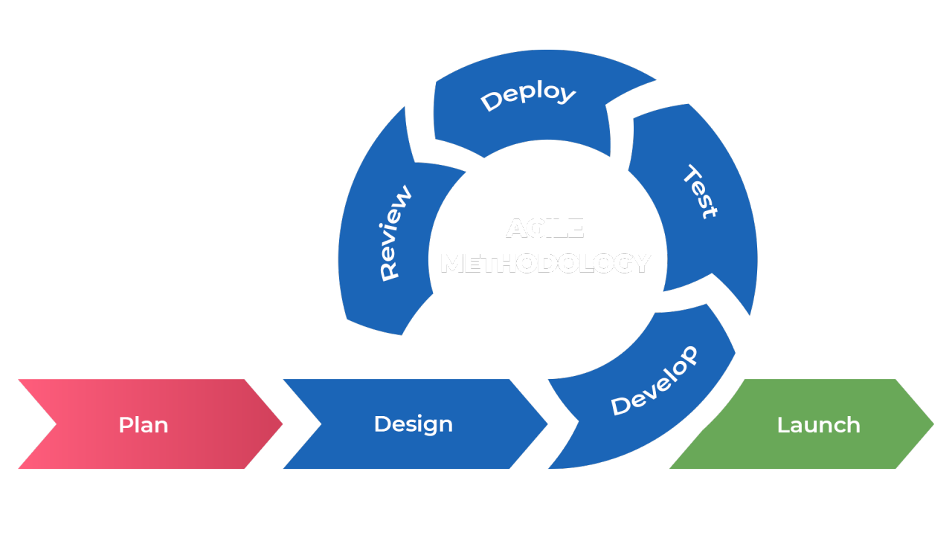
Introduction to Process Models
5. Agile Model (Iterative, Collaborative Approach)
Encourages iterative development with continuous user feedback.
Uses frameworks like Scrum, Kanban, and XP (Extreme Programming).
Scrum: is a management framework that teams use to self-organize tasks and work towards a common goal.
Kanban: A visualization tool that gives a perfect overview of the ongoing work status and simplifies team collaboration and communication.

Slide 15
Introduction to Process Models
5. Agile Model (Iterative, Collaborative Approach)
Strengths: Flexible, high user involvement, quick delivery of functional software.
Weaknesses: Requires strong collaboration, less suited for projects with strict regulations.
Example: Used in startups and evolving software products like mobile applications.

Slide 16
Week Agenda
Introduction to Process Models
Traditional vs. Agile Requirements Engineering
Documenting Requirements
Quality Measurement in Requirements Engineering
Activity & Case Study

Slide 17
Traditional vs. Agile Requirements Engineering
Requirements engineering involves gathering, documents primary and managing system requirements.
Two primary approaches exist: Traditional (Waterfall) and Agile (Scrum etc.).
The choice of approach impacts flexibility, efficiency, and project success.

Slide 18
Traditional Requirements Engineering
Characteristics:
Follows a structured, sequential approach.
Detailed upfront documentation.
Requirements are fixed early in the project lifecycle.
Minimal flexibility once requirements are set.

Slide 19
Traditional Requirements Engineering
Strengths:
Well-suited for projects with clearly defined requirements.
Strong documentation and compliance support.
Predictable timeline and budget.
Weaknesses:
High risk of requirement changes being costly.
Late-stage feedback leads to expensive fixes.
Inflexible when requirements evolve.

Slide 20
Traditional Requirements Engineering
Example:
Used in government and large-scale enterprise systems where regulations require fixed documentation and predictability.

Slide 21
Agile Requirements Engineering
Characteristics:
Iterative and incremental development.
Requirements evolve based on continuous feedback.
Emphasizes working software over detailed documentation.
Collaboration between stakeholders and development teams is crucial.

Slide 22
Agile Requirements Engineering
Strengths:
Adaptable to changing requirements and customer feedback.
Reduces risk by validating requirements through iterative development.
Delivers functional software quickly and continuously.
Weaknesses:
Requires close collaboration and strong team communication.
Can be difficult to maintain documentation consistency.
Not ideal for projects with strict regulatory requirements.

Slide 23
Agile Requirements Engineering
Example:
Startups and dynamic industries (e.g., mobile app development, SaaS platforms) benefit from Agile due to evolving requirements and rapid iterations.

Slide 24
Comparison Table!
Feature | Traditional Model (Waterfall) | Agile Model
Documentation | Heavy, upfront | Lightweight, evolving
Flexibility | Rigid | Adaptive
Feedback Loop | Delayed | Continuous
Risk Handling | Higher due to late feedback | Lower due to early iterations
Development Speed | Slower due to upfront planning | Faster with incremental releases
Customer Involvement | Limited to initial and final stages | Continuous throughout development

Slide 25
Hybrid Approach: Best of Both Worlds
Some projects use a Hybrid Model, integrating structured documentation from traditional methods with Agile’s adaptability.
Example: Large enterprises may document key requirements upfront but use Agile sprints to refine features based on real-world feedback.

Slide 26
Case Study Agile vs. Waterfall in a Real-World Project

Slide 27
Case Study (1)
Scenario:
A banking company initially followed the Waterfall model to develop an online banking system.
Challenges arose when unexpected regulatory changes required modifications.
Switching to Agile for mobile banking allowed incremental changes and rapid adaptation.

Slide 28
Case Study (2)
Analysis & Lessons Learned
Impact of Switching from Waterfall to Agile
Before the Switch (Waterfall Challenges)
After the Switch (Agile Benefits)

Slide 29
Case Study (3)
Before the Switch (Waterfall Challenges)
Regulatory changes caused major delays in project timelines.
Late-stage modifications were expensive and required reworking large portions of the system.
Limited stakeholder involvement resulted in features that didn’t fully align with user needs.

Slide 30
Case Study (4)
After the Switch (Agile Benefits)
Iterative development allowed the company to adapt to regulatory updates faster.
Continuous feedback from customers helped refine the mobile banking app.
Shorter release cycles meant that features were tested and deployed incrementally.

Slide 31
Key Metrics for Success Evaluation (5)
Metric | Waterfall (Before) | Agile (After)
Time to Market | Delayed due to rework | Faster due to incremental releases
Cost of Changes | High (late-stage modifications) | Lower (early feedback-driven changes)
Customer Satisfaction | Low (rigid, predefined system) | High (customer-driven improvements)
Compliance Handling | Reactive, costly changes | Proactive, iterative compliance integration

Slide 32
Lessons Learned (6)
Agile works best for evolving regulatory environments, allowing frequent updates.
Waterfall is useful for initial large-scale system documentation but lacks flexibility.
A Hybrid Approach can balance both:
Use Waterfall for initial planning & compliance-heavy components.
Use Agile for feature enhancements, user experience improvements, and regulatory adjustments.

Slide 33
Final Outcome & Future Recommendations (7)
The online banking system (built in Waterfall) serves as a stable, core backend.
The mobile banking system (built in Agile) evolves continuously based on market needs.
Future projects should evaluate complexity & regulatory risks before choosing a model.

Slide 34
Week Agenda
Introduction to Process Models
Traditional vs. Agile Requirements Engineering
Documenting Requirements
Quality Measurement in Requirements Engineering
Activity & Case Study

